Slide 1
LG BOOSTING
(or)
Light Gradient Boosting

Slide 2
The "LG boost algorithm" is most likely referring to the Light Gradient Boosting Machine, or LightGBM, an efficient, high-performance machine learning framework developed by Microsoft. It is a gradient boosting algorithm that uses decision trees as weak learners, but with key innovations that make it significantly faster than other implementations like XGBoost.

Slide 3
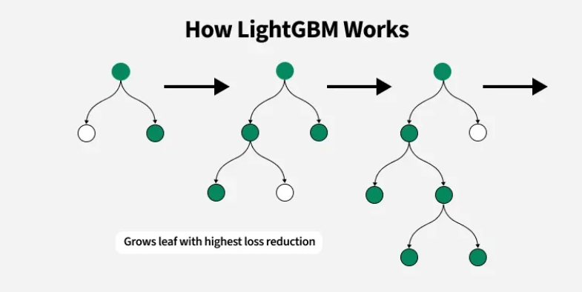
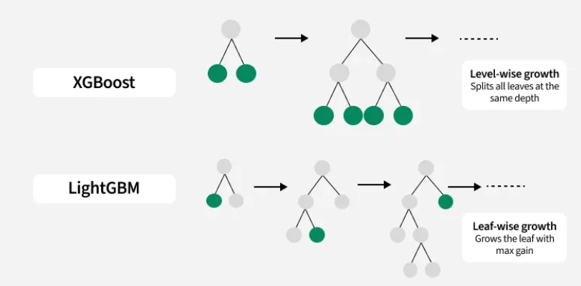
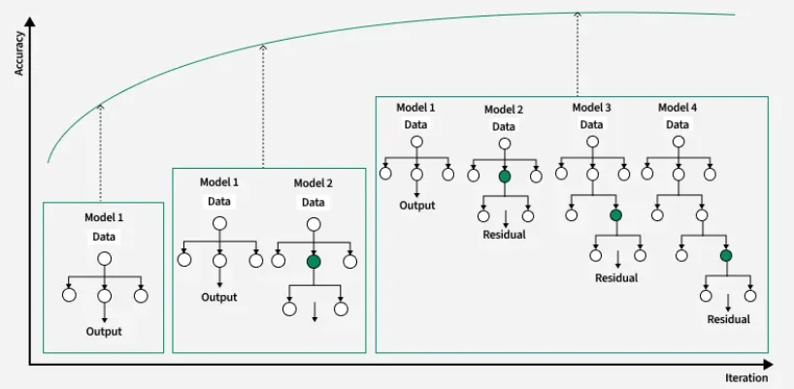

Slide 4
Core Mechanism: Gradient Boosting
At its foundation, LightGBM is a gradient boosting algorithm. This method works by:
Initial Prediction: Starting with a simple initial model (usually the mean of the target variable).
Iterative Correction: Sequentially adding new, "weak" decision trees to the model. Each new tree is trained to predict the residuals (errors) made by the combined predictions of all previous trees.
Minimizing Loss: Using gradient descent to minimize a predefined loss function (e.g., mean squared error for regression) with each added tree, ensuring that each step moves the model closer to an accurate prediction.
Final Model: The final prediction is the weighted sum of all the weak learners' predictions, scaled by a learning_rate to prevent overfitting.

Slide 5
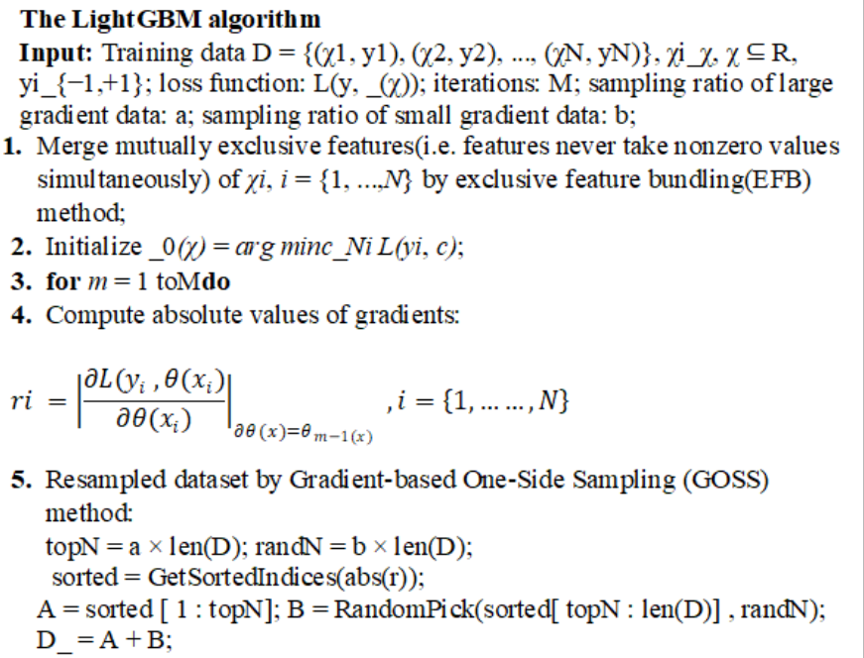

Slide 6
